Slide 1
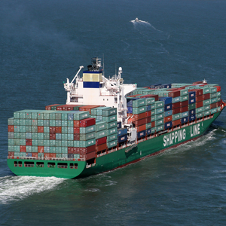
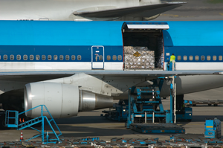
COMMERCIAL EXPORT

Slide 2
COMMERCIAL expORT
Exporters of commercial goods must register with JAMPRO before exporting
www.jamaicatradeandinvest.org
Email: info@jamprocorp.com

Slide 3
COMMERCIAL expORT
Things to Consider:
All items leaving the island subject to Border Controls
No tax levied on export
All export cargo subject to scanning at all ports
Intrusive examinations conducted on risk assessment

Slide 4
COMMERCIAL EXPORT
THE EXPORTER DOES NOT NEED TO REGISTER IF:
The items are personal effects
The item was a temporary import
The item is being exported temporarily
The import duty was paid and the item is subsequently being re-exported

Slide 5
COMMERCIAL EXPORT
LAWS GOVERNING EXPORT:
The Customs Act – Part V, sections 133-159
  Section 145 – general provisions
  Section 156 – exporter to notify short-loading of cargo
    To notify of short loading in Kingston: exportmarinekgn@jacustoms.gov.jm

Slide 6
COMMERCIAL EXPORT
CERTIFYING BODIES:
The Trade Board 967-0507
Ministry of Agriculture 977-0637
National Environment & Planning Agency (NEPA) 754-7540
Coffee Industry Board 758-1442
Coconut Industry Board 926-1770
Bureau of Standards 926-3140

Slide 7
COMMERCIAL expORT
STEPS:
Register with JAMPRO
Complete booking with shipping company
Apply for an ASYCUDA account (1st time exporters) – awinfo@jacustoms.gov.jm
ASYCUDA – Automated System for Customs Data

Slide 8
COMMERCIAL expORT
STEPS continued:
Prepare export declaration in ASYCUDA – Export Single Administrative Document (ESAD)
Upload all required documents
Note the ESAD reference number
Pay at the Customs cashier – ($3000 + $5)

Slide 9
COMMERCIAL expORT
STEPS continued:
Take Dock Receipt (by sea) or Tally sheet (by air) & necessary permits to the Export Officer
Deliver Cargo to the wharf (by sea) or warehouse (by air)

Slide 10


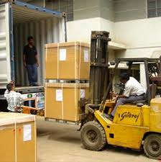
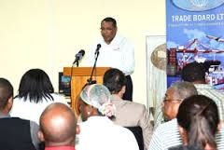
COMMERCIAL expORT
BORDER CONTROL
Begins with the Exporter

Slide 11
COMMERCIAL expORT
BORDER CONTROL:
The Export Officer
The Cargo Imaging Officer
The Contraband Enforcement Team (CET)

Slide 12

COMMERCIAL expORT
CONTACT:
CET – 923-7641/757-3912
BERTH XI – 923-7018 ext. 360, 480 or 319
KINGSTON WHARVES – 923- 9211 ext. 5688
NORMAN MANLEY INTERNATIONAL AIRPORT (AIR CARGO) – 924-8084
CUSTOMS HOUSE (KINGSTON) – 922-5140-9
MONTEGO FREEPORT – 979-8126
SANGSTER INTERNATIONAL AIRPORT (AIR CARGO)– 952-2537
  MONTEGO BAY REVENUE CENTER (CUSTOMS) – 952-0000
  www.jacustoms.gov.jm

